Slide 1
Vampire attacks: Draining life from wireless ad-hoc sensor networks
Presented By
E.Madhukar(12011M2110)
R.ChandrahasRaju(12011M2109)
K.Maheshwar(11011M2210)
Under the Guidance of
Prof.M.NAGARATNA

Slide 2
Keywords
Depletion Attack: is the consumption of a resource faster than it can be replenished(refill)
Wireless Sensor Network: spatially distributed autonomous sensors to monitor physical or environmental conditions, such as temperature, sound, pressure etc. and to cooperatively pass their data through the network to a main location.
Ad-hoc Network: is a decentralized type of wireless network. The network is ad hoc because it does not rely on a pre existing infrastructure.
Mitigate: Make less severe, painful.

Slide 3
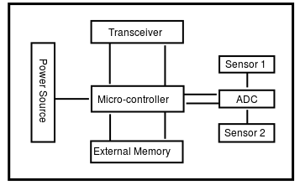
Sensor Node Architecture.

Slide 4
ABSTRACT
Ad-hoc low-power wireless networks are an exciting research direction in sensing computing. Prior security work in this area has focused primarily on denial of communication at the routing or medium access control levels.
This paper explores resource depletion attacks at the routing protocol layer, which permanently disable networks by quickly draining nodes’ battery power. These “Vampire” attacks are not specific to any specific protocol, but rather rely on the properties of many popular classes of routing protocols. We find that all examined protocols are susceptible to Vampire attacks, which are devastating, difficult to detect, and are easy to carry out using as few as one malicious insider sending only protocol compliant messages. In the worst case, a single Vampire can increase network-wide energy usage by a factor of O(N), where N in the number of network nodes. We discuss methods to mitigate these types of attacks, including a new proof-of-concept protocol that provably bounds the damage caused by Vampires during the packet forwarding phase.

Slide 5
Introduction
Wireless sensor networks (WSNs) promise exciting new applications in the near future, such as ubiquitous on-demand computing power, continuous connectivity, and instantly-deployable communication for military and first responders. Such networks already monitor environmental conditions, factory performance, and troop deployment, to name a few applications.
As WSNs become more and more crucial to the everyday functioning of people and organizations, availability faults become less tolerable — lack of availability can make the difference between business as usual and lost productivity, power outages, environmental disasters, and even lost lives; thus high availability of these networks is a critical property, and should hold even under malicious conditions. Due to their ad-hoc organization, wireless ad-hoc networks are particularly vulnerable to denial of service (DoS) attacks

Slide 6
Introduction
While these schemes can prevent attacks on the short-term availability of a network, they do not address attacks that affect long-term availability — the most permanent denial of service attack is to entirely deplete nodes’ batteries. This is an instance of a resource depletion attack, with battery power as the resource of interest.
Vampire attacks are not protocol-specific, in that they do not rely on design properties or implementation faults of particular routing protocols, but rather exploit general properties of protocol classes such as link-state, distance-vector, source routing, and geographic and beacon routing. Neither do these attacks rely on flooding the network with large amounts of data, but rather try to transmit as little data as possible to achieve the largest energy drain, preventing a rate limiting solution. Since Vampires use protocol-compliant messages, these attacks are very difficult to detect and prevent.

Slide 7
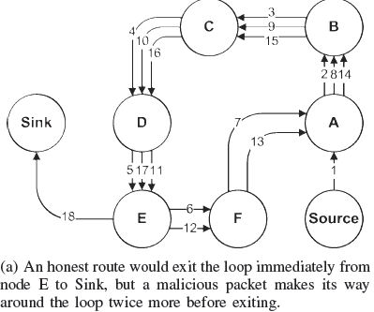
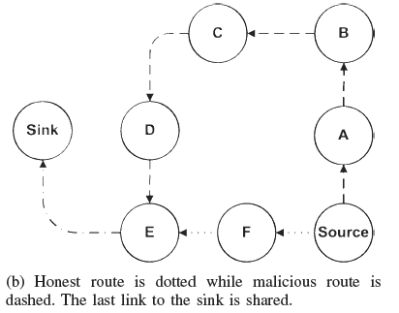
Introduction

Slide 8
Vampire Attack
We define a Vampire attack as the composition and transmission of a message that causes more energy to be consumed by the network than if an honest node transmitted a message of identical size to the same destination, although using different packet headers. We measure the strength of the attack by the ratio of network energy used in the benign case to the energy used in the malicious case, i.e. the ratio of network-wide power utilization with malicious nodes present to energy usage with only honest nodes when the number and size of packets sent remains constant

Slide 9
Carousel attack & Stretch Attack
In this attack, an adversary sends a packet with a route composed as a series of loops, such that the same node appears in the route many times. This strategy can be used to increase the route length beyond the number of nodes in the network, only limited by the number of allowed entries in the source route. See Fig 1. a.
Another attack in the same vein is the stretch attack, where a malicious node constructs artificially long source routes, causing packets to traverse a larger than optimal number of nodes. An honest source would select the route Source → F → E → Sink, affecting four nodes including itself, but the malicious node selects a longer route, affecting all nodes in the network. These routes cause nodes that do not lie along the honest route to consume energy by forwarding packets they would not receive in honest scenarios

Slide 10
EXISTING SYSTEM
Existing work on secure routing attempts to ensure that adversaries cannot cause path discovery to return an invalid network path, but Vampires do not disrupt or alter discovered paths, instead using existing valid network paths and protocol compliant messages. Protocols that maximize power efficiency are also inappropriate, since they rely on cooperative node behavior and cannot optimize out malicious action.

Slide 11
Disadvantages of the existing system.
If a node battery power has down, it can’t deliver the messages to the destination.
If attacks are being happened just for message transferring, the utilization of the battery will be very high.

Slide 12
Attacks on Stateless Protocol.
Here we present simple but previously neglected attacks on source routing protocols, such as DSR [35]. In these systems, the source node specifies the entire route to a destination within the packet header, so intermediaries do not make independent forwarding decisions, relying rather on a route specified by the source.
To forward a message, the intermediate node finds itself in the route (specified in the packet header) and transmits the message to the next hop. The burden is on the source to ensure that the route is valid at the time of sending, and that every node in the route is a physical neighbor of the previous route hop. This approach has the advantage of requiring very little forwarding logic at intermediate nodes, and allows for entire routes to be sender-authenticated using digital signatures,

Slide 13
H/W System Configuration:-
Processor - Pentium – III
RAM - 256 MB(min)
Hard Disk - 40 GB
Key Board - Standard Windows Keyboard
Mouse - Two or Three Button Mouse
Monitor - SVGA

Slide 14
S/W System Configuration:-
Operating System : Windows XP / 7
Language : Java, Swings, Networking

Slide 15
PROPOSED SYSTEM
So, inorder to avoid the vampire attacks, we study that topology discovery and packet forwarding which will takes the message to the destination where attacks may not happen.

Slide 16
CLEAN-SLATE SENSOR NETWORK ROUTING
The original version of the protocol, although designed for security, is vulnerable to Vampire attacks. PLGP consists of a topology discovery phase, followed by a packet forwarding phase, with the former optionally repeated on a fixed schedule to ensure that topology information stays current. (There is no on-demand discovery.) Discovery deterministically organizes nodes into a tree that will later be used as an addressing scheme. When discovery begins, each node has a limited view of the network — the node knows only itself. Nodes discover their neighbors using local broadcast, and form ever-expanding “neighborhoods,” stopping when the entire network is a single group. Throughout this process, nodes build a tree of neighbor relationships and group membership that will later be used for addressing and routing

Slide 17
Topology Discovery
Discovery begins with a time-limited period during which every node must announce its presence by broadcasting a certificate of identity, including its public key (from now on referred to as node ID), signed by a trusted offline authority. Each node starts as its own group of size one, with a virtual address 0. Nodes who overhear presence broadcasts form groups with their neighbors. When two individual nodes (each with an initial address 0) form a group of size two, one of them takes the address 0, and the other becomes 1. Groups merge preferentially with the smallest neighboring group, which may be a single node. We may think of groups acting as individual nodes, with decisions made using secure multiparty computation.

Slide 18
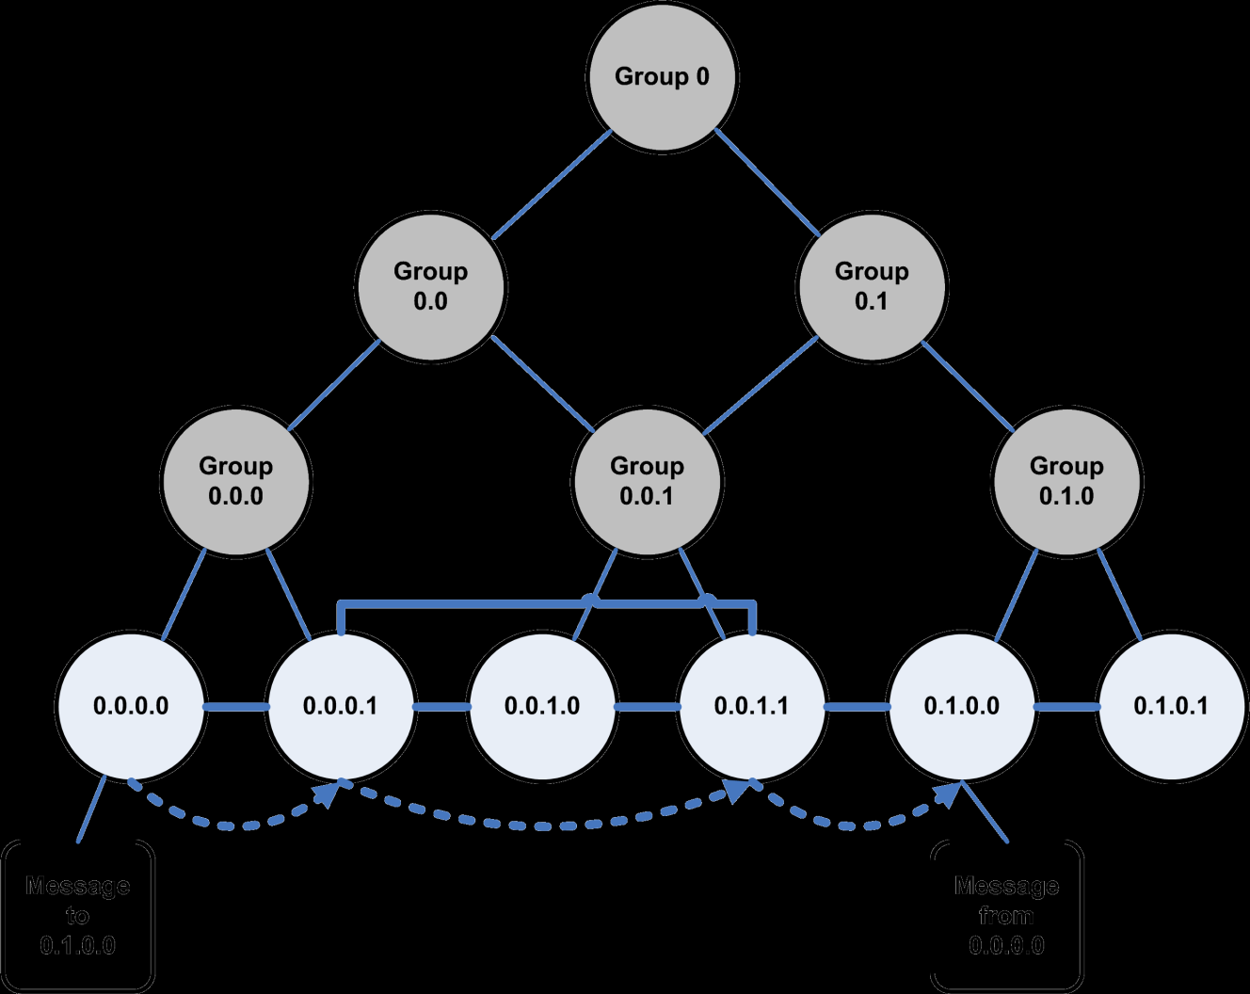
Topology discovery

Slide 19
Packet forwarding
During the forwarding phase, all decisions are made independently by each node. When receiving a packet, a node determines the next hop by finding the most significant bit of its address that differs from the message originator’s address.
Thus every forwarding event shortens the logical distance to the destination, since node addresses should be strictly closer to the destination.

Slide 20
System Design

Slide 21
Use Case Diagram

Slide 22
Class Diagram

Slide 23
Sequence Diagram

Slide 24
Activity Diagram

Slide 25
Conclusion
In this paper we defined Vampire attacks, a new class of resource consumption attacks that use routing protocols to permanently disable ad-hoc wireless sensor networks by depleting nodes’ battery power. These attacks do not depend on particular protocols or implementations, but rather expose vulnerabilities in a number of popular protocol classes.

Slide 26
REFERENCES
Imad Aad, Jean-Pierre Hubaux, and Edward W. Knightly, Denial of service resilience in ad hoc networks, MobiCom, 2004.
Gergely Acs, Levente Buttyan, and Istvan Vajda, Provably secure ondemand source routing in mobile ad hoc networks, IEEE Transactions on Mobile Computing 05 (2006), no. 11.
Tuomas Aura, Dos-resistant authentication with client puzzles, International workshop on security protocols, 2001.
John Bellardo and Stefan Savage, 802.11 denial-of-service attacks: real vulnerabilities and practical solutions, USENIX security, 2003.

Slide 27
Thank You

